Slide 1



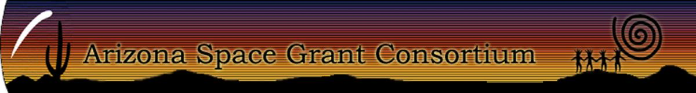
Predictive Modeling of Temperature and Precipitation Over Arizona
Sereena Ginar
Mentor: Dr. Xubin Zeng
Susan Stillman
Department of Hydrology & Atmospheric Sciences
NASA Symposium, April 22nd, 2017
Arizona State University

Slide 2
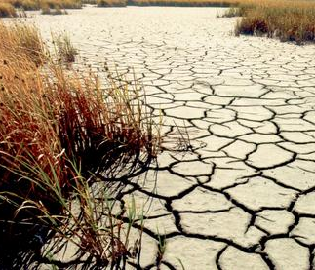
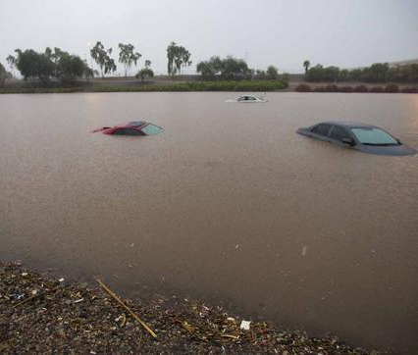
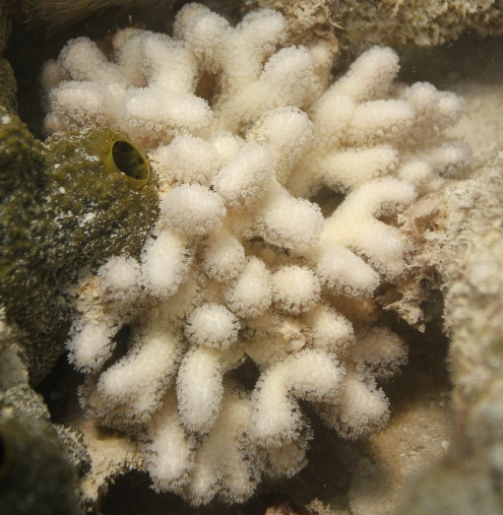

Predictive Climate Modeling
Statistical modeling using the National Centers for Environmental Prediction’s observational database
Seasonal weather anomalies in the Southwestern United States
http://www.eco-poetry.org/marilyn_kiss.html https://twitter.com/missrosenido http://www.aoml.noaa.gov/keynotes/keynotes_1015_coralbleachingresearch.html

Slide 3
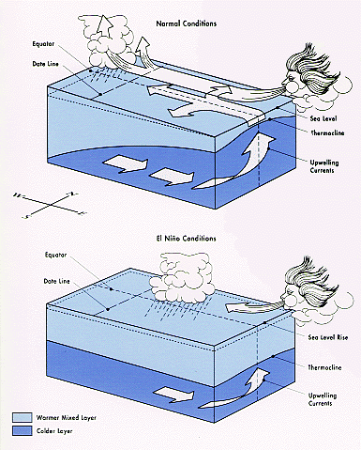
El Niño Southern Oscillation
Climate phenomenon consisting of oceanic and atmospheric components
https://www.ncdc.noaa.gov/teleconnections/enso/enso-tech.php

Slide 4
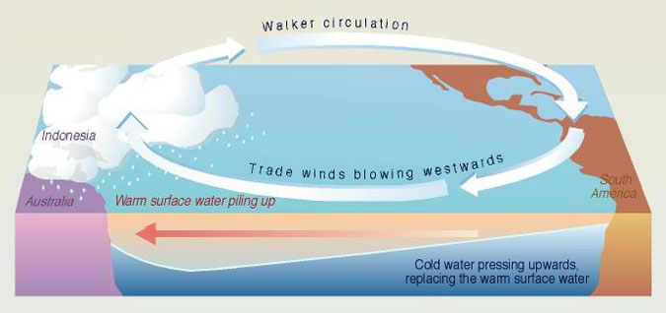
The Walker Circulation
Vertical circulation system connecting the Southern Oscillation and Sea Surface Temperatures in the western and equatorial Pacific Ocean
http://www.southwestclimatechange.org/figures/walker_circulation

Slide 5
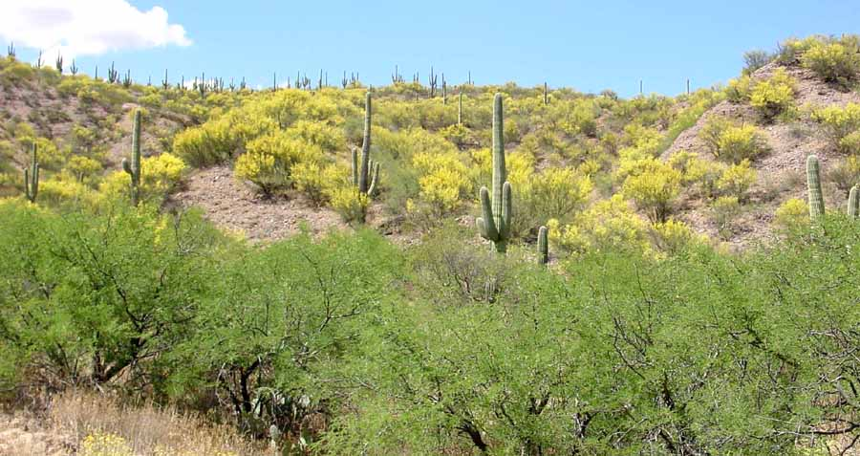

ENSO Events
Coupling of unusually warm/cold surface waters in the Eastern Pacific Ocean at the end of the year and a negative/positive Southern Oscillation Index (SOI)
Anomalous precipitation in the middle of the following year
Not directly correlated with Southwest winter precipitation
http://www.saguaro-juniper.com/i_and_i/san_pedro/ecoregions/arizona_uplands.html
https://mizzoumag.missouri.edu/2013/05/if-trees-could-talk/

Slide 6
Objectives
Quantify the skill of the predictions from the National Oceanic and Atmospheric Administration (NOAA) National Centers for Environmental Prediction (NCEP)
Test a statistical model for the seasonal prediction of temperature and precipitation over Arizona

Slide 7
Data Analysis and Results
Correlations between Arizona precipitation anomalies and the seasonal averages of various climate indices
  ENSO indices, sea level pressure, sea surface temperatures, Pacific Decadal Oscillation (PDO)
No positive results were found
  Limited predictive power of PDO

Slide 8
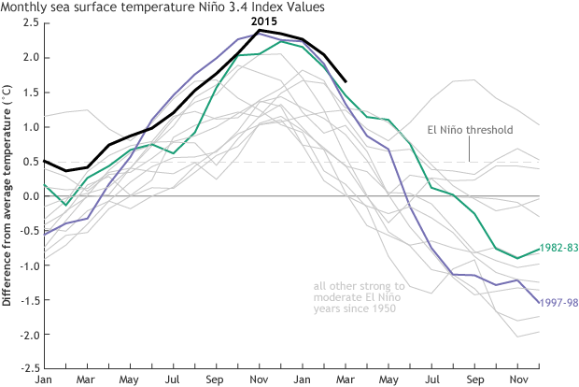
Significance
The observed climate indices may not have a substantial impact on anomalous temperature and precipitation in Arizona
Exploration of further predictors
https://www.climate.gov/news-features/blogs/enso/april-2016-el-ni%C3%B1ola-ni%C3%B1a-update-what-goes-%E2%80%A6

Slide 9


Acknowledgements
Dr. Xubin Zeng
Susan Stillman
Department of Hydrology & Atmospheric Sciences
University of Arizona
NASA Space Grant

Slide 10
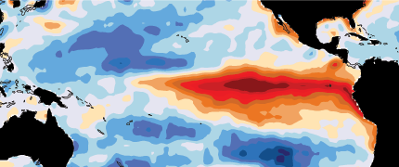

Thank You

